Slide 1
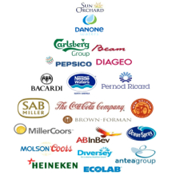
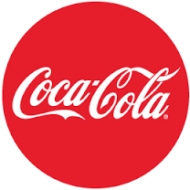
UNDERSTANDING THE BEVERAGE INDUSTRY
USING COCA – COLA COMPANY
FOR OUR RESEARCH
GROUP NO: 04
GROUP MEMBERS:
Aditya Joshi
Dongcheng
Pulkit Jain
Saurabh Jape
Yash Kelkar

Slide 2
TABLE OF CONTENTS
PART 1: INDUSTRY ANALYSIS
PART 2: NATIONAL ENVIRONMENT
COUNTRY 1: UNITED STATES OF AMERICA
COUNTRY 2: CHINA
COUNTRY 3: SOUTH AFRICA
PART 3: SYNTHESIS

Slide 3
PART 1: INDUSTRY ANALYSIS
The Soft Drink Manufacturing market is predominantly ruled by three players, Coca-Cola Company (28.6%), PepsiCo Inc (26.8%) and Dr Pepper (8.6%).
The Coca-Cola Company in itself is the world’s largest nonalcoholic beverage company with above 500 brands, few of them alone generating more than a billion dollars revenue each.

Slide 4
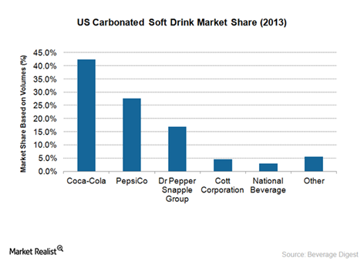
PART 1: INDUSTRY ANALYSIS (contd.)
PepsiCo owns the leading brands across its snack foods and beverage portfolio, with 22 brands generating more a billion dollars each in revenue. The companies have a combined share of about 70% of the US carbonated soft drink (CSD) market.

Slide 5
PART 1: INDUSTRY ANALYSIS (contd.)
The products of soft drink production are distributed to six main segments. Supermarkets and general merchandisers represent the largest channel.
The consumer purchases from here, soft drinks, which accounts for 48% of the market.
The other five segments included in the soft drink market include are Food Service and drinking places.
20% of market includes fast-food outlets, take-out outlets, full-service restaurants and bars, convenience stores, gas stations.
12% of the market includes stand-alone convenience stores and stored attached to the gas stations.
11% of the market included vending machines in transportation outlets or other areas of convenience.
The other 8% of the market includes smaller outlets such as drug stores, community centers, and private clubs.
Exports account for 1% of the market, including to exports to Canada, Japan and Mexico.

Slide 6
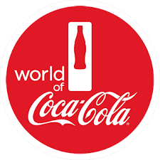
The Coca-Cola Company
Founded in 1892
Sales- 3300 products in over 200 countries
Revenue (in 2015)- $44 billion
No. of employees- 123,200

Slide 7
SWOT Analysis
Strengths
Brand Awareness
Weaknesses
Water Management
Threats
Nutritious Selections
Opportunities
Diversification
Robust Distribution Network
Foreign Currency Fluctuation
Extended Reach
Indirect Competition

Slide 8
Strategic Management of Information Systems
ERP Solutions
Outsourcing
Supply Chain
Customer Care Provision
Database use

Slide 9
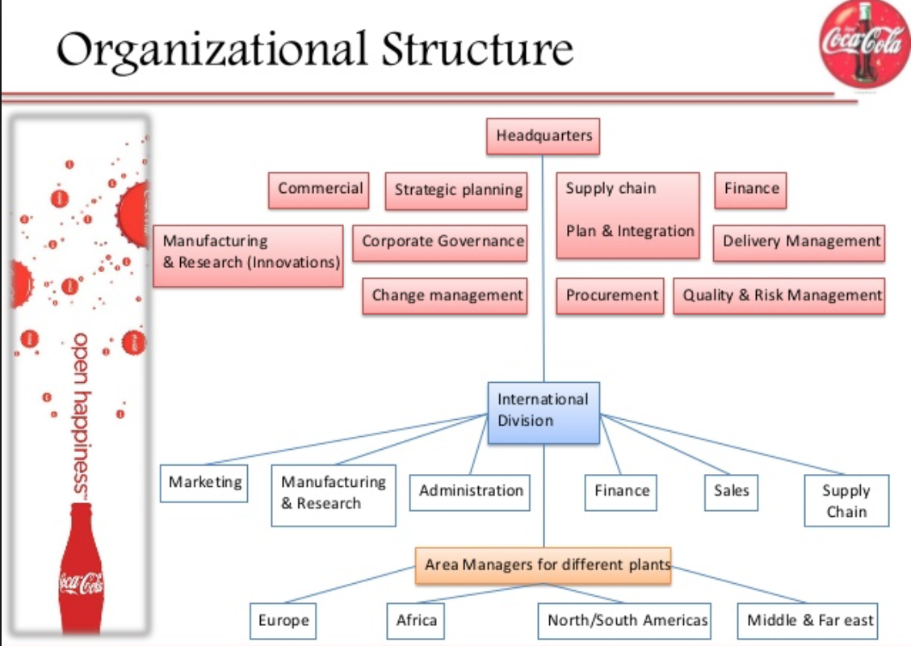
PART 2:
NATIONAL ENVIRONMENT

Slide 10
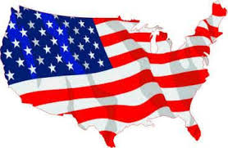
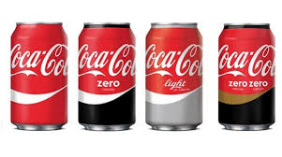
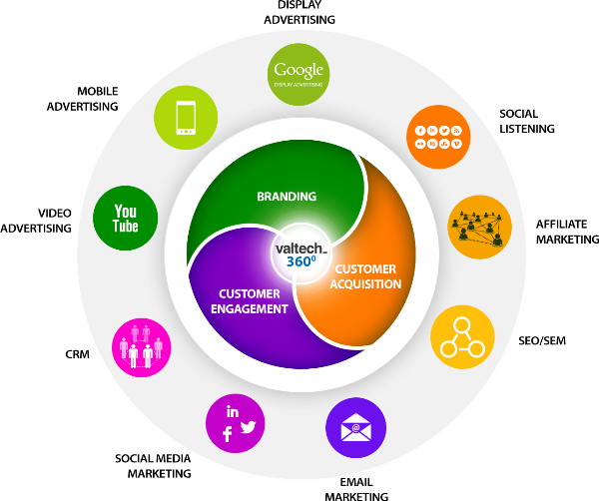
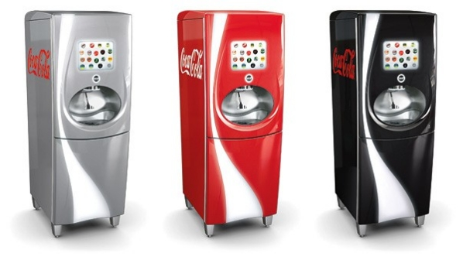
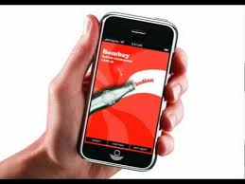
Country 1: Coca-Cola in USA

Slide 11
National and Industry environment
4th largest population in the world of about 323,995,528
15 to 64 which is about 65% of the total population of the united states
Fairly stable GDP since the past 10 years having per capita of $55,800.
Provides them work force expert in manufacturing, sales domain which comprises of about 45% of the total work force
Country has the highest number of airports, biggest network of roadways and railways provides them to export the products all around the world.
Market share for the leading soft drink companies in the United States, the Coca-Cola Company, PepsiCo and Dr. Pepper Snapple contributed 42.8%, 31.1% and 16.1% respectively.

Slide 12
Cultural and Policy Factors
Sustainable manufacturing in a company is very important to maintain a good reputation.
Country barriers and thus cultural barriers are relatively low for the beverage industry in the united states.
Communicating its image as a global brand to change people’s perception.
The industry expects its buyers to be able to think of their drink as something which connects the world together
Political conditions like a civil conflict, governmental change and or restriction concerning the ability to reallocate capital across borders can affect a company
Penetrating emerging and developing markets depends on economic and political conditions as well as the industry’s ability to form effectively strategic business alliances with local bottlers, and to enhance their production amenities, distribution networks, sales equipment and technology.
Changes in the laws and regulations like accounting standards, taxation requirements and environmental laws either in domestic or foreign authorities can influence the decision making.
Change in the non-alcoholic business era, where the competitive product and pricing policy pressures, and ability to maintain or earn share of sales in worldwide market compared to competitors

Slide 13
Strategic Analysis
Coca cola specifically have changed their strategy in this competitive market to increase their market share by 2020 by double the amount.
There are 5 major strategy changes:
Packaging
Partnerships
Inventing or launching new products. (Over 500 new products)
Engagement program which provokes happiness
Cultural leadership.

Slide 14
IS Strategic Environment
Information system
Manage inventory data, project data, accounting data, and so on
Save labor
Increase efficiency
Customer Relationship Management
Loyalty program, My Coke Rewards
Mobile applications
IT Improvement
Content management system
Digital rights system
Mobile distribution system

Slide 15
Value Chain (IS Strategic Environment)
2.4 million delivery points through over 430 distribution centers
Coca-Cola’s delivery is streamlined by implementing the vehicle routing software.
Coca-Cola created a global supply chain through a franchising model. They only produce key raw materials, such as beverage bases and syrups. These raw materials will then be sold to 300 bottling partners throughout the world. Then, franchisees in each area can make the final products by adding water, sweeteners and carbonates. The finished products will then be sold via the retailing partners.

Slide 16
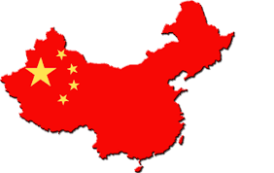
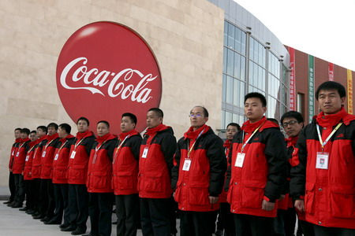
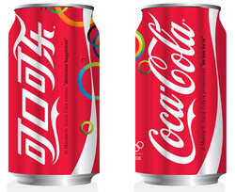
Country 2: Coca-Cola in China

Slide 17
National and Industry environment
Demographic and economics
1.3 billion people in China
390 million people are under 30 years old – target group of consumers
Information infrastructure
Phone lines: 230.996 million subscriptions
Mobile phone users: 1305.738 million ---- Every person in China has a mobile phone
Internet users: 687.845 million
Coca-Cola’s strategy: Digital marketing like social media marketing
Human Resources
Labor Cost is doubled compared with five years ago, e.g. increased from 165USD to 322USD
Coca-Cola takes advantage of Information System and Digital marketing and branding in order to cut labor cost.

Slide 18
National and Industry environment
Cultural factors
Chinese Culture: People like to try foreign drinks or food.
Coca-Cola benefit from this culture, became largest foreign market outsite US in 1948
Policy environment
Obstrution: China was using a closed, centrally planned system. Coca-Cola had to quit Chinese market.
Opportunity: Until 1979, China encourage foreign companies like Coca-Cola to come back to Chinese market.
Consumer preferences
Coca-Cola is the most popular brand in soft drinks industry in China.
25 percent of market share in China
More Details about Soft drink industry
Each year, every person in China, on average, consumes 24 bottles of soda.

Slide 19
Strategic Analysis
Coca-Cola is the leading firm in soft drink industry in China.
When labor cost in China was low: Hired more worked
When labor cost in China increased: Focus on IT and try to replace traditional labor
Successful digital marketing and branding strategy
Social media
Logo
Advertisement via different media channel

Slide 20
IS Strategic Environment
Information system
Manage inventory data, project data, accounting data, and so on
Save labor
Increase efficiency
Customer Relationship Management
Loyalty program, My Coke Rewards
Mobile applications
IT Improvement
Content management system
Digital rights system
Mobile distribution system

Slide 21
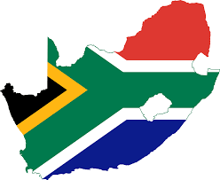
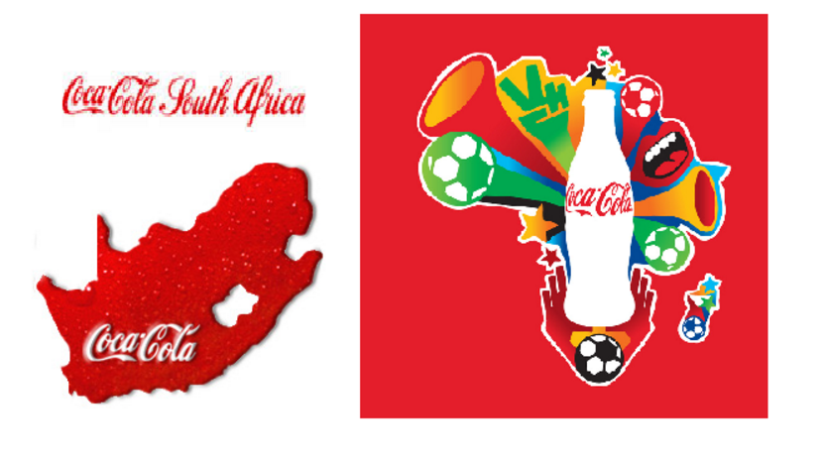
Country 3: Coca-Cola in South Africa

Slide 22
National and Industry environment
South Africa has a population of over 53 million, 59% of which is Coca-Cola’s primary target consumers.
The Coca-Cola system provides employment and income for South African citizens as well as tax revenue for local and central governments.
Employee well being is an integral part of Coca Cola SA culture. SA is a culture of individualism and Indulgence.
South African policies align with Coca-Cola’s multinational outlook
Brand name is critical to consumer preference of Coke.

Slide 23
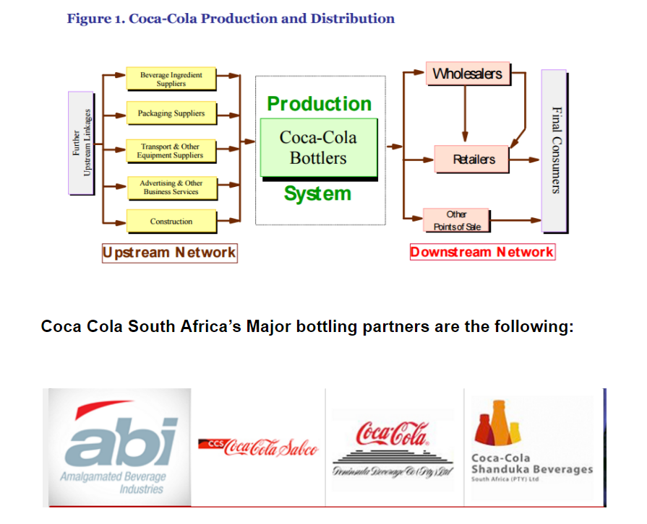
Strategic Analysis
Coca-Cola enjoys a dominant market due to its long established history in the country, strong distribution network, and aggressive marketing techniques.
Coca Cola also boasts a well developed Distribution system, with the help of four major bottling partners.

Slide 24
IS Strategic Environment
Coca-Cola introduced greener bottles and packaging in 2009.
Coca-Cola harnesses the power of social networking to spread the word concerning new products, etc.
Coca-Cola began rolling out its freestyle dispensers. The dispenser records information concerning consumers' drink choices, then sends the data back to Coca-Cola as market research.
“IT and marketing are very close partners at Coca-Cola today.” - Ed Steinike, vice president and CIO of The Coca-Cola Company

Slide 25
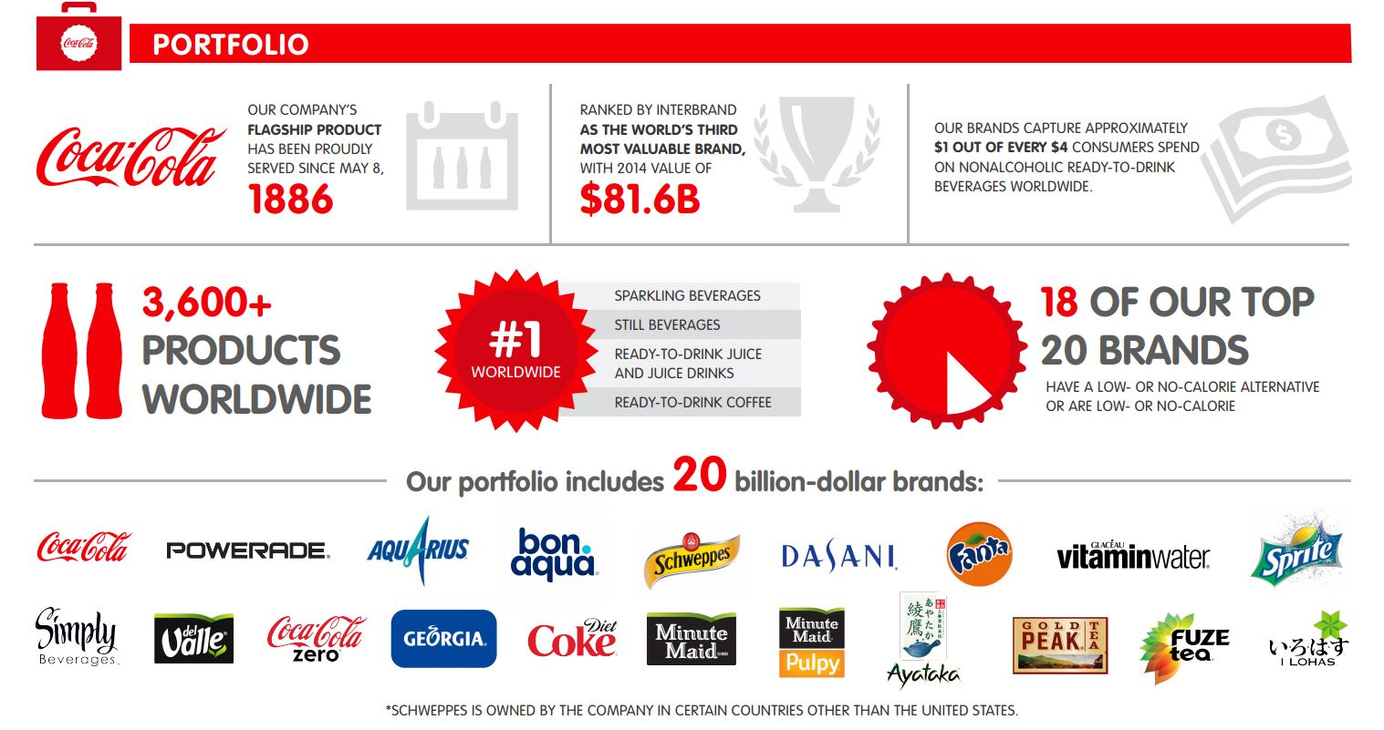
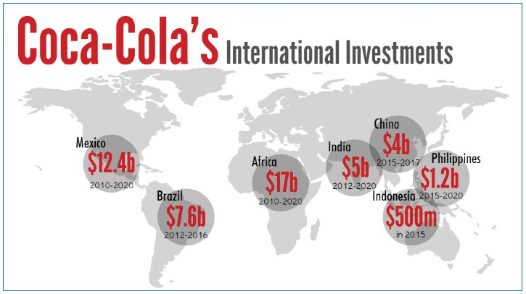
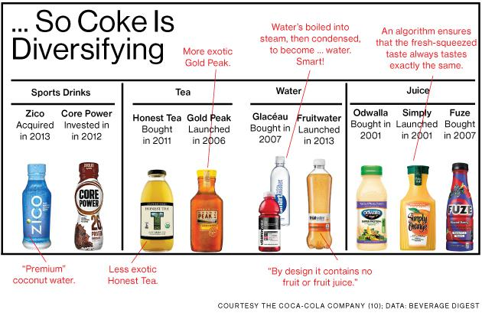
What can we learn from
Coca Cola?
Focus on Portfolio
Diversification
Cultural Investments
Technological Improvements

Slide 26
PART 3:
SYNTHESIS
From our analysis of Coca Cola, we can gain an insight into the Beverage Industry and how a company needs to strategies in order to become a leader in the market as Coca Cola was able to:
Each organization in the beverage industry has to adopt its business strategies to generate revenue and growth according to the different countries it operates in.
National environment drives how an organization behaves. Organizations need to analyze consumer and local preferences and adapt their business models accordingly.
An understanding of consumer preference is highly required.
National environment drives how an organization behaves, the product that a beverage industry organization releases, needs to be improved with time. This could be through new features, improved services or newer varieties.

Slide 27
Acquisitions and Partnerships are key to the survival and expansion of beverage companies.
An understanding of the roadblocks and issues are key in process improvement and organizational restructuring.
Political conditions and demography, play a very important role for organizations to gain access to a new market.
To ensure that the company is able to utilize its information, feedback channels are required to be setup.
For beverage companies to expand, getting its supply chain to be efficient, lesser lead times and high efficiency are some of its major challenges.
Technology and Information flow, plays a very vital role. It helps integrate all the different business functions in a manner that the system is coherent with latest information what can be shared globally.

Slide 28
Increasing amount of new brands and kinds of energy drink, soda and juice products appearing in the market with similar prices.
Efficient advertising, marketing and promotional programs affect the business process.
Every company plans to be to be in par with its coca cola by having an ability to effectively promote their products through these channel to impact sales.
Packaging design easy to carry and dispose.
Since the technology is continuously advancing, new equipment are constantly. For instance, mobile app
Production of smaller cans containing lesser quantity at a faster rate.
Innovation. People will like to purchase the good even though price is high because no substitutes are available if the product is innovative. It may also give the industry brand loyalty which means customers will stay loyal to them.

Slide 29
THANK
YOU

